Slide 1
Intelligent Flashcards
Andre, Joshua, Saanvi, Vainavi

Slide 2
Why use Intelligent Flashcards?

Slide 3
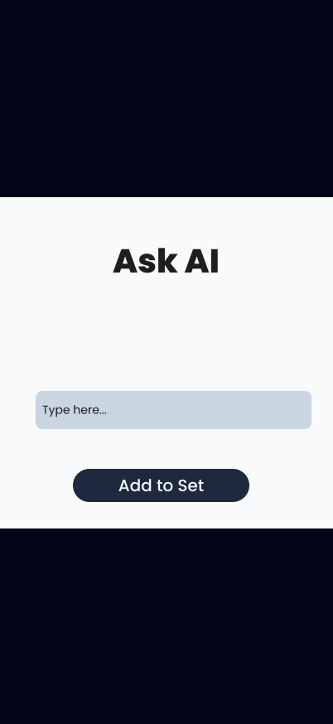
Create flashcards using AI!
Type in a chatbox
Add cards to Set of Flashcards

Slide 4
Why use Intelligent Flashcards?
Enables you to create and review flashcards faster!

Slide 5
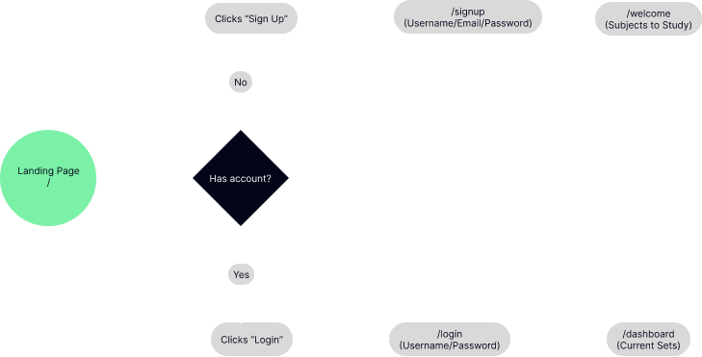
User Flow Diagrams

Slide 6
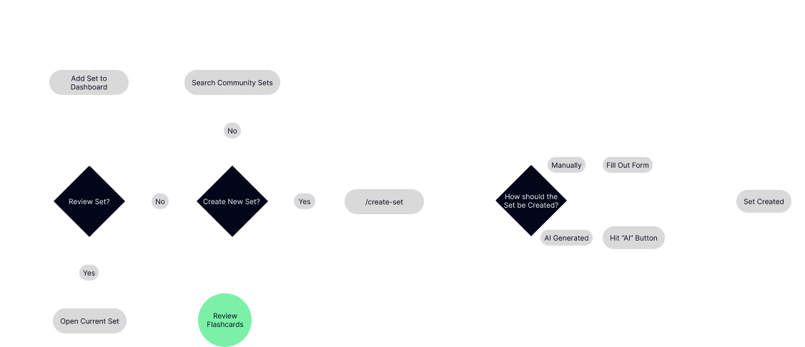
User Flow Diagrams

Slide 7
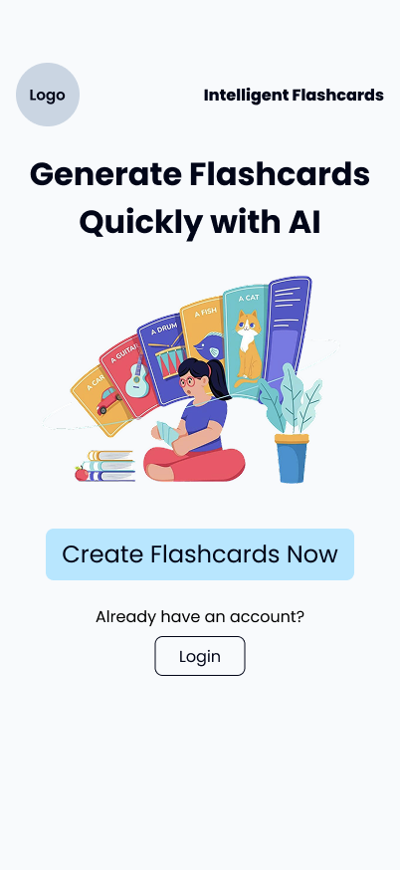
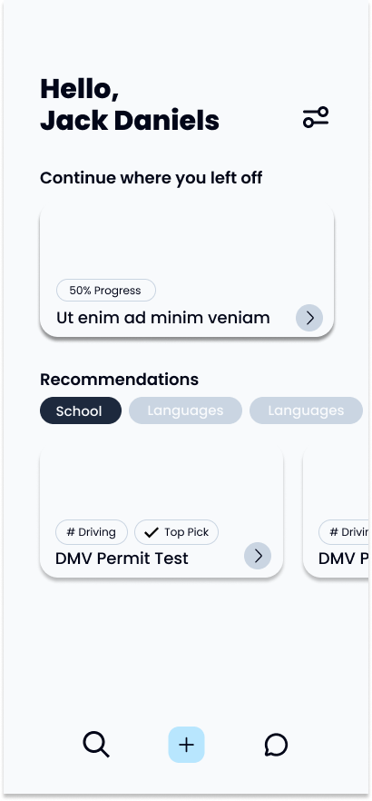
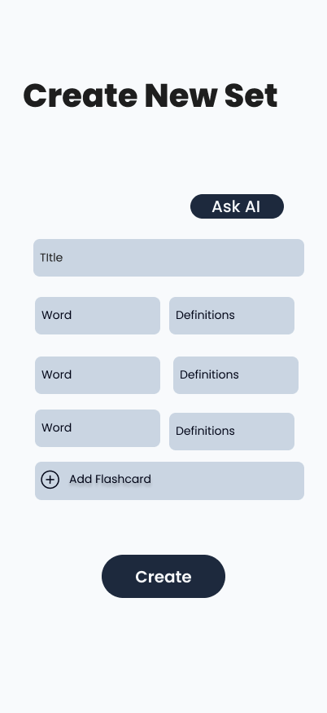
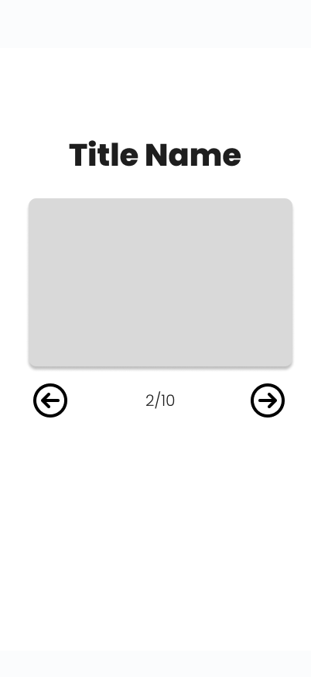
User Interface

Slide 8
Demo!

